Slide 1


NEXT GEN EMPLOYABILITY PROGRAM
CREATING A FUTURE-READY WORKFORCE
Student Name :
Vaibhav Tiwari
Student ID :
College Name :
STU65daede0d4c6c1708846560
Lovely Professional University

Slide 2
CAPSTONE PROJECT SHOWCASE
Project Title
Building Customer Segmentation Model Using Python
Abstract | Problem Statement | Project Overview | Proposed Solution | Technology Used | Modelling & Results | Conclusion | Q&A

Slide 3
Abstract
1
Objective: Develop a customer segmentation model using K-Means Clustering.
2
Methodology: Cleaned and transformed data into customer-centric dataset, preprocessed it, and utilized K-Means & DBSCAN algorithms & developed a recommendation system.
3
Results: Successfully segmented the customer base into three distinct groups with unique profiles and preferences.
4
Impact: By leveraging segmented customer data, the recommendation system provides personalized product suggestions.

Slide 4


Problem Statement
Our project aims to optimize marketing strategies and boost sales by implementing a customer segmentation model using the K-means clustering and DBSCAN algorithm. Leveraging a transactional dataset from a UK-based retailer, our goal is to transform the data into a customer-centric format, creating features that facilitate the segmentation of customers into distinct groups. Through this segmentation, we aim to uncover unique profiles and preferences within the customer base.
Subsequently, we plan to develop a recommendation system that suggests top-selling products to customers within each segment who haven't made those specific purchases, ultimately enhancing marketing efficiency and fostering increased sales.

Slide 5
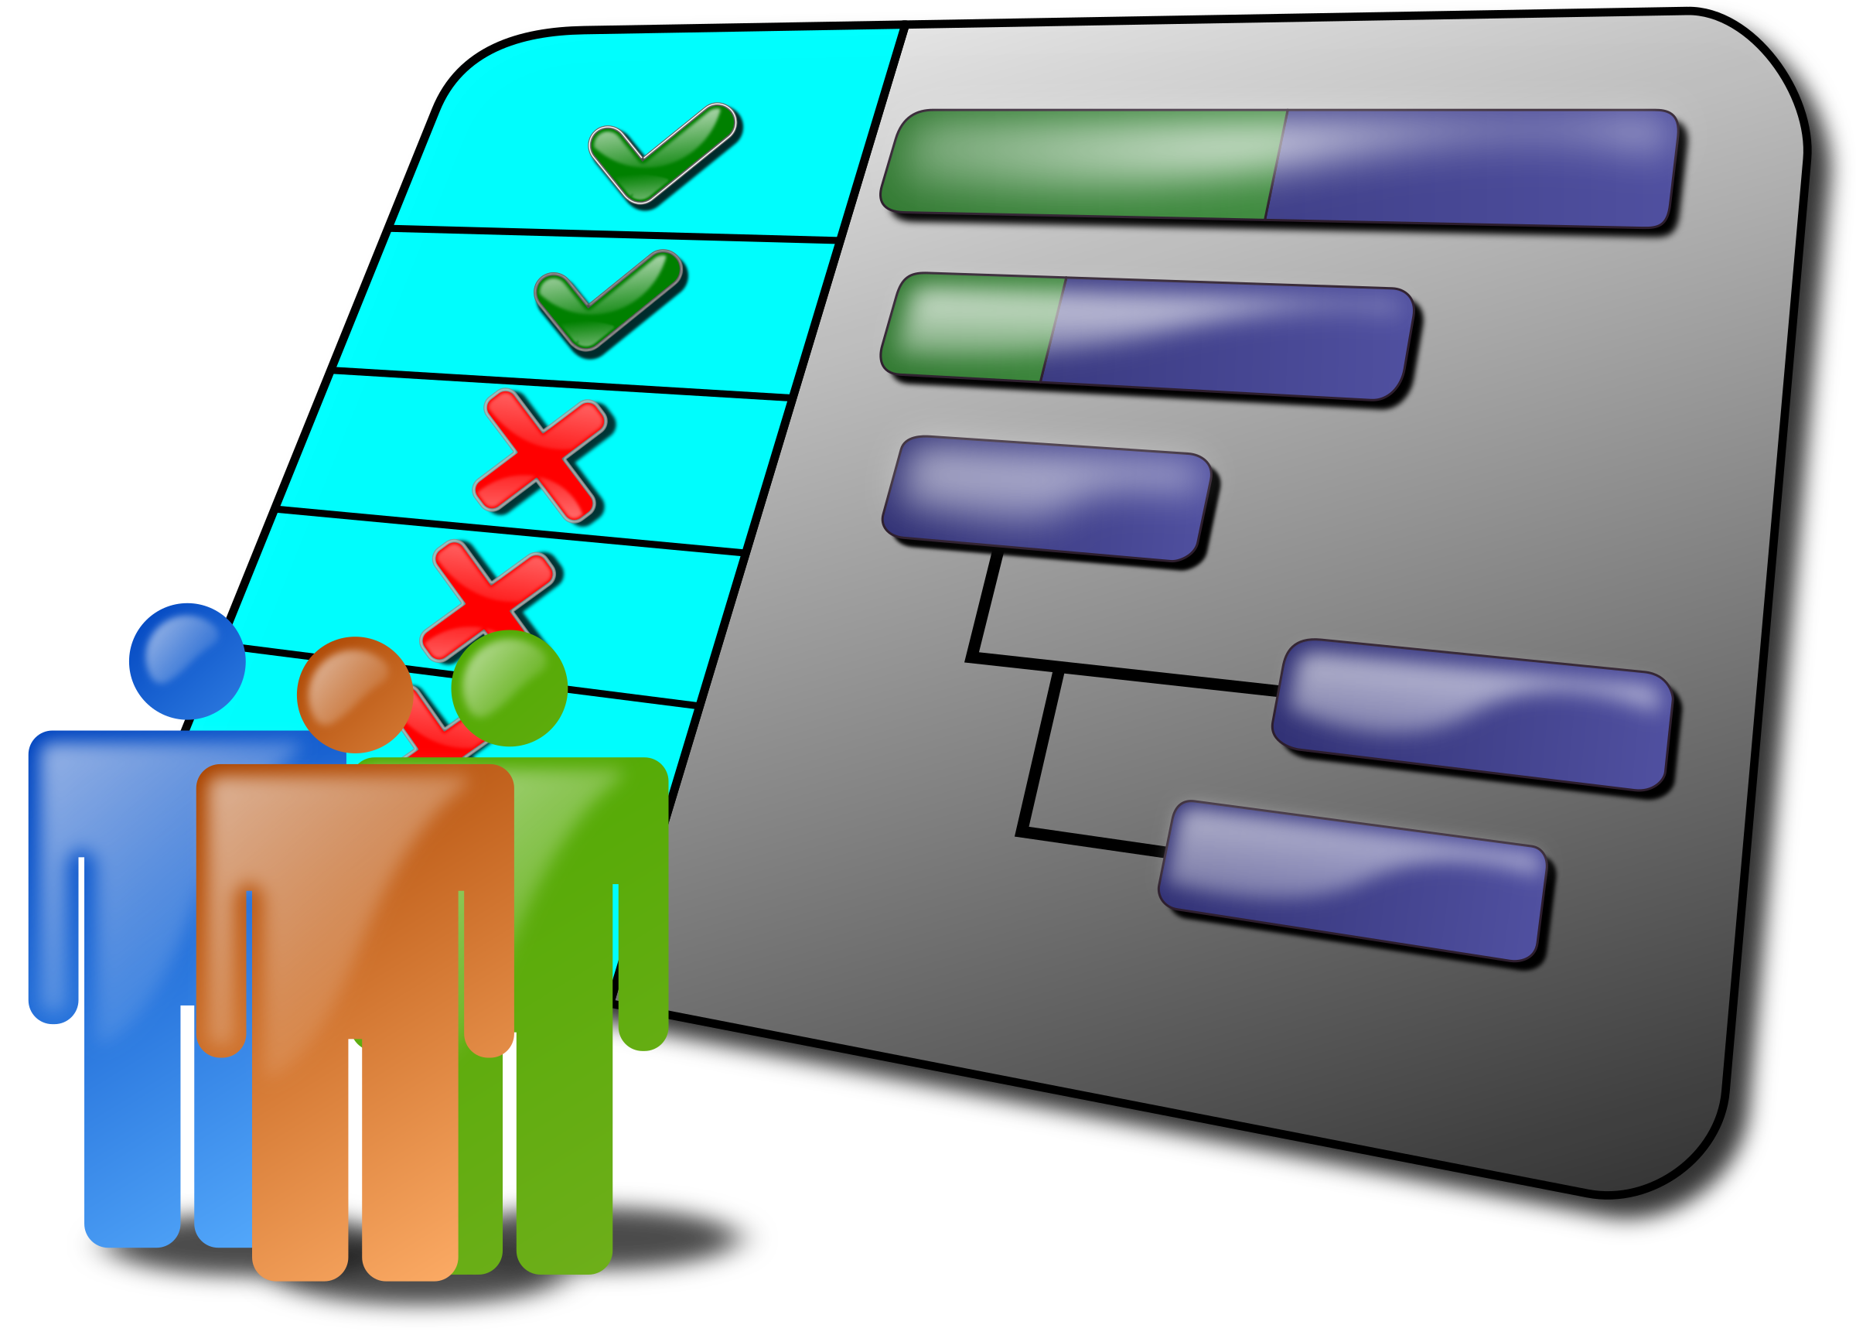
Project Overview
Introduction: Customer segmentation, the process of dividing a customer base into distinct groups with similar characteristics, allows businesses to tailor their offerings and communications to better resonate with different segments.
Objective: This project aims to employ advanced data science and ML methodologies to segment our customer base effectively. By identifying homogeneous groups of customers with shared traits and preferences, we seek to optimize marketing efforts, improve customer engagement, and ultimately drive business success

Slide 6

Project Overview
APPROACH
Data Cleaning: Addressed missing values, duplicates, and outliers to ensure dataset integrity.
Feature Engineering: Created a customer-centric dataset by deriving new features capturing behavior and demographics.
Data Preprocessing: Conducted feature scaling and dimensionality reduction for consistent data representation.
Customer Segmentation: Applied K-means clustering to group customers based on similarities.
Cluster Evaluation: Analyzed clusters using metrics like silhouette scores for meaningful segmentation.
Recommendation System: Developed a system leveraging segmented data for personalized recommendations.

Slide 7
Proposed Solution
Our proposed solution involves a multi-step approach to address the challenges outlined in the problem statement:
Data Transformation and Feature Engineering: We will begin by transforming the transactional dataset from the UK-based retailer into a format conducive to customer segmentation. Through extensive feature engineering, we will create customer-centric features that encapsulate various aspects of customer behavior, preferences, and demographics.
Customer Segmentation using K-means Clustering & DBSCAN: Employing the K-means clustering & DBSCAN algorithm and comparing the results to find out the better one, we will segment the customer base into distinct groups based on similarities in their features. By iteratively refining the clustering process and evaluating cluster quality, we aim to achieve robust and meaningful segmentation.

Slide 8
Proposed Solution
Insights Generation and Profile Identification: Post-segmentation analysis will entail uncovering unique profiles and preferences within each customer segment. Through in-depth exploration of cluster characteristics and visualization techniques, we will derive actionable insights to inform marketing strategies.
Recommendation System Development: Building upon the segmented customer data, we will develop a recommendation system tailored to each customer segment. By leveraging collaborative filtering techniques and historical transaction data, the system will suggest three top-selling products to customers who have not yet made those specific purchases. This personalized approach aims to enhance marketing efficiency and drive increased sales.

Slide 9

Technology used
Python (Jupyter Notebook)
K-Means Algorithm
DBSCAN Algorithm
Libraries
Numpy
Pandas
Matplotlib
Seaborn
Scipy
Scikitlearn

Slide 10
Modelling & Result
Model Development :The customer segmentation model was constructed using the K-means clustering & DBSCAN algorithm, popular unsupervised learning techniques suitable for partitioning data into distinct clusters. We compared the results and opted for K-means due to its better results on our data than DBSCAN.
Model Evaluation: To assess the quality of the segmentation model, we employed several evaluation metrics, including the silhouette score and Davies–Bouldin index. These metrics provided valuable insights into the compactness and separation of the clusters.
Metric | Value | Inferences
Number of Observations | 4067 | --
Silhouette Score | 0.24 | fair amount of separation between the clusters
Calinski Harabasz Score | 1257.17 | clusters are well-defined
Davies Bouldin Score | 1.37 | decent separation between the clusters

Slide 11
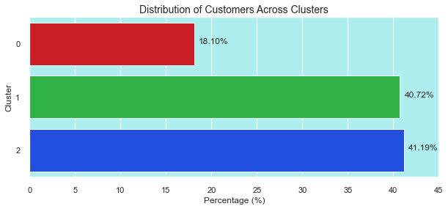
Modelling & Result
Result Interpretation: The segmentation analysis yielded compelling results, identifying 3 distinct customer segments with unique characteristics and behaviors.

Slide 12
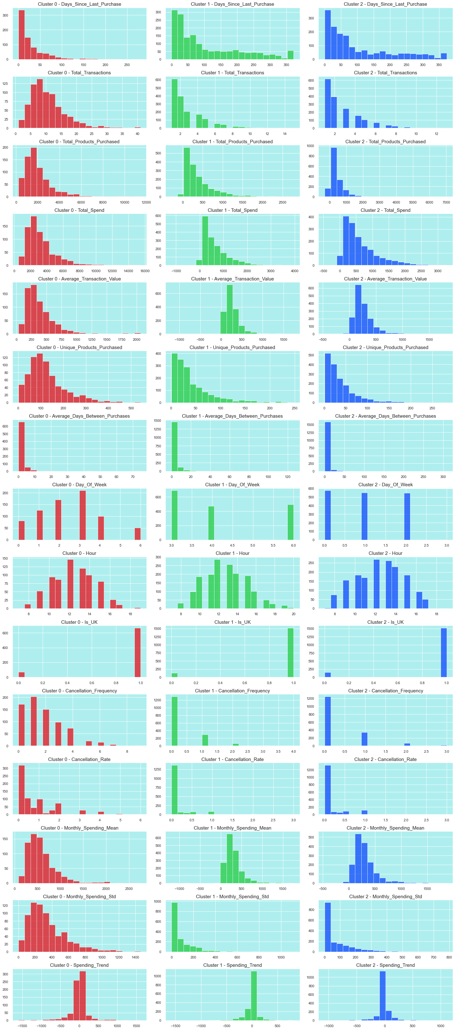
Modelling & Result
Cluster 0 :IMPULSIVE EARLY PURCHASERS
This cluster is characterized by:
High Spenders: Customers here exhibit high spending habits, purchasing a wide variety of unique products across numerous transactions.
Potential Impulsiveness: Despite high spending, a significant portion of their transactions are cancelled, suggesting impulsive buying behavior.
Early Bird Activity: They tend to shop during the early hours, possibly due to time constraints before daily commitments or to take advantage of early-bird deals.
Variable Spending Patterns: Their monthly spending fluctuates considerably, indicating less predictable shopping habits.
Shifting Trends: Interestingly, their overall spending trend shows a slight decline, potentially signaling a future change in their shopping behavior.

Slide 13

Modelling & Result
Cluster 1 : TARGETED WEEKEND SHOPPERS
This cluster is characterized by:
Lower Purchase Frequency & Spend: Compared to other segments, these customers shop less frequently and spend less overall.
Fewer Transactions & Products: They typically have a smaller number of transactions and purchase fewer products per shopping trip.
Weekend Shopping Preference: They exhibit a preference for shopping during weekends, suggesting a more casual browsing or window-shopping approach.
Stable Spending Patterns: Their monthly spending remains quite consistent with minimal fluctuations.
Decisive Purchases: They rarely cancel transactions, indicating a more decisive shopping style.
Lower Transaction Value: When they do shop, their average spending per transaction tends to be lower compared to other clusters.

Slide 14
Modelling & Result
Cluster 2 : IRREGULAR HIGH-VALUE BUYERS
This cluster is defined by the following characteristics:
Infrequent Shopping with High Spends: They make purchases infrequently but spend significantly when they do, often buying a variety of products.
Increasing Expenditure: Their spending has been on the rise, suggesting a growing interest or investment in their purchases.
Later Shopping Hours: They tend to shop later in the day, possibly after work hours.
UK-Based Customers: This customer segment is primarily located in the UK.
Moderate Cancellations: They exhibit a moderate tendency to cancel transactions, which could be due to reevaluating higher-priced purchases.
Substantial Purchases: Their purchases are generally of larger value, indicating a preference for quality or premium products.

Slide 15
Conclusion
The implementation of a customer segmentation model using the K-means clustering algorithm can be instrumental in optimizing marketing strategies and boosting.
Through meticulous data preprocessing, feature engineering, and segmentation analysis, three distinct customer segments with unique profiles and preferences were identified.
The development of a recommendation system further enhances the impact of the segmentation model by delivering personalized product suggestions to customers, thereby increasing customer engagement and driving incremental sales revenue.
Overall, the successful execution of this project underscores the significance of leveraging data science methodologies to unlock valuable insights from customer data, empowering organizations to make informed decisions and achieve sustainable business growth in a competitive market environment.

Slide 16


Notes:
Thank You !!

